Slide 1




Investing in our greatest asset: Roads

Slide 2




Highlights the advantages of asphalt pavements and how asphalt is meeting the challenges of today’s environment.
AsphaltAdvantages.com

Slide 3
The campaign offers the latest industry news and information about upcoming programs and events.
AsphaltAdvantages.com

Slide 4
AsphaltAdvantages.com which is the hub for all information and efficiently categorized into 4 key themes for easy reference. Sustainability, Comfort, Safety, and Economics.
AsphaltAdvantages.com

Slide 5
Learn about asphalt advantages and the important role it plays in
^{our daily activities.}
AsphaltAdvantages.com

Slide 6
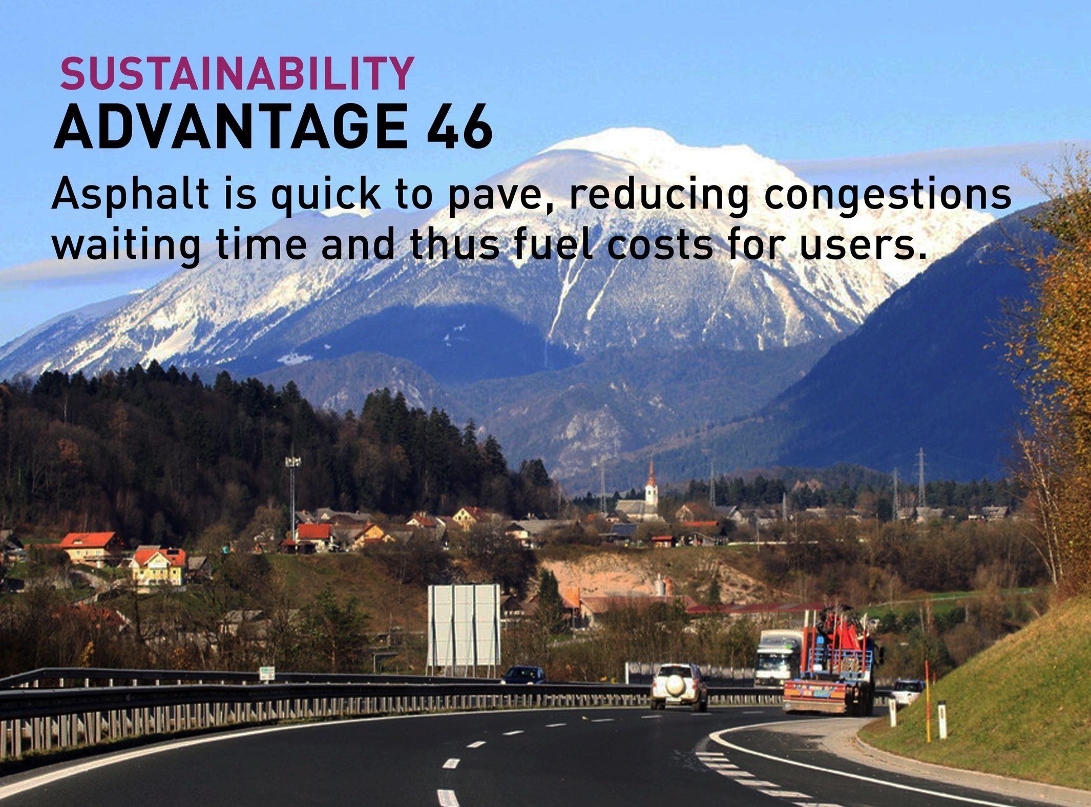

Slide 7
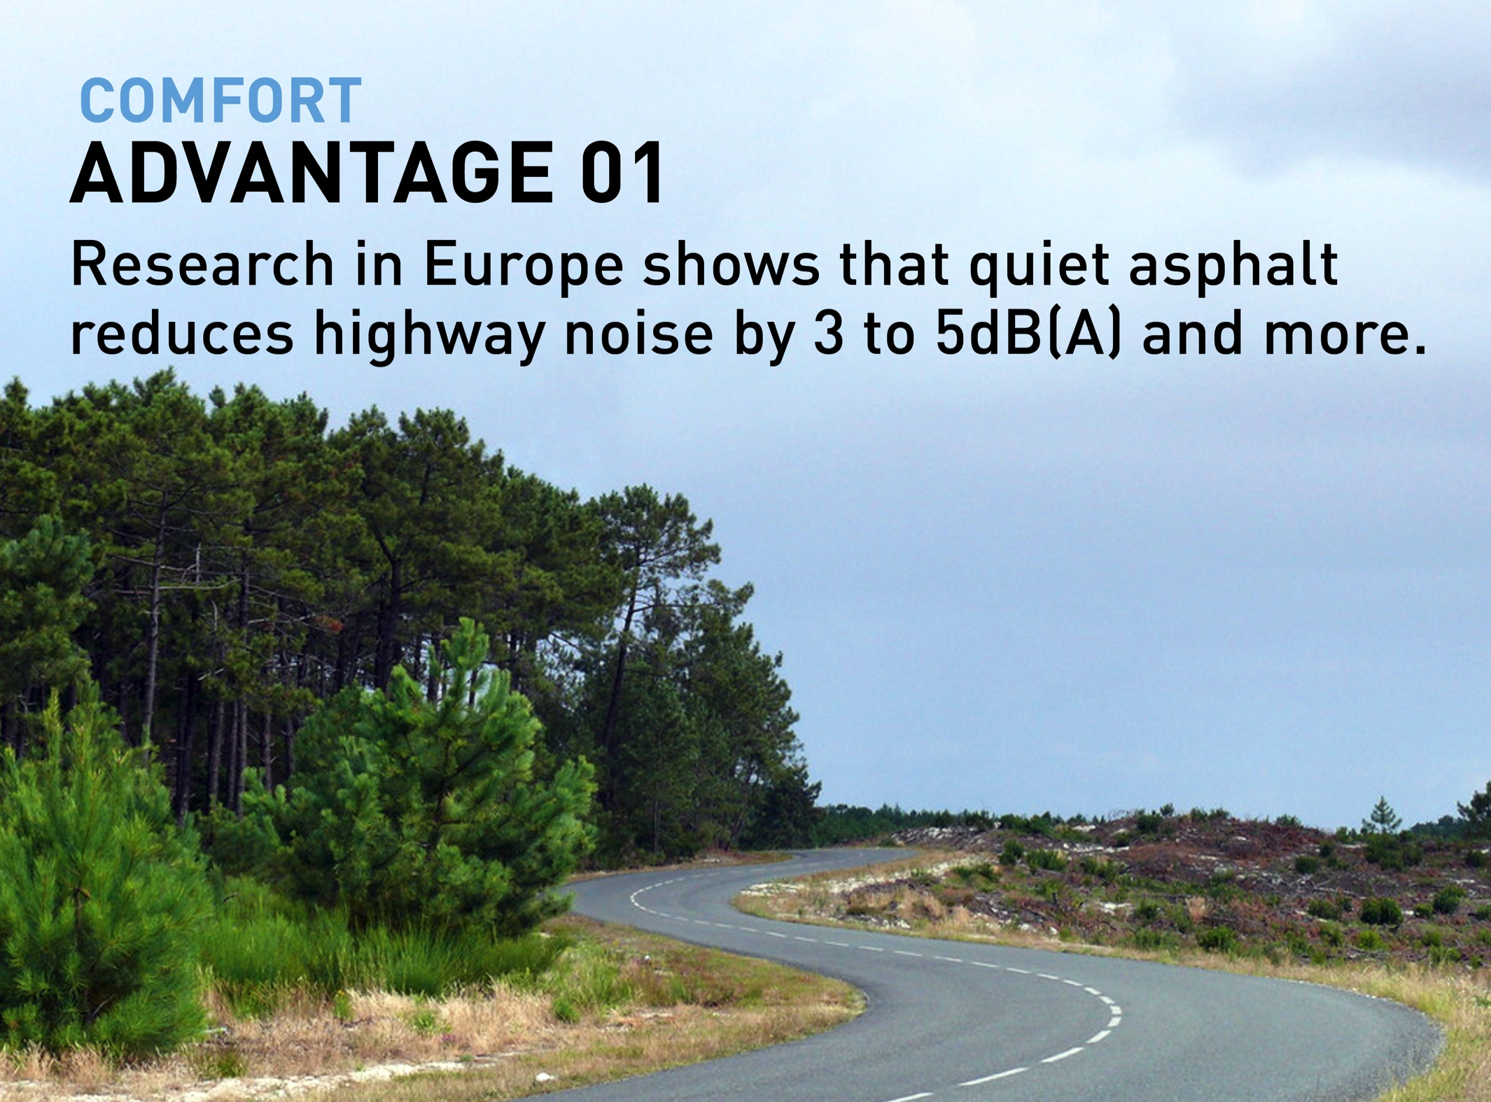

Slide 8


Slide 9
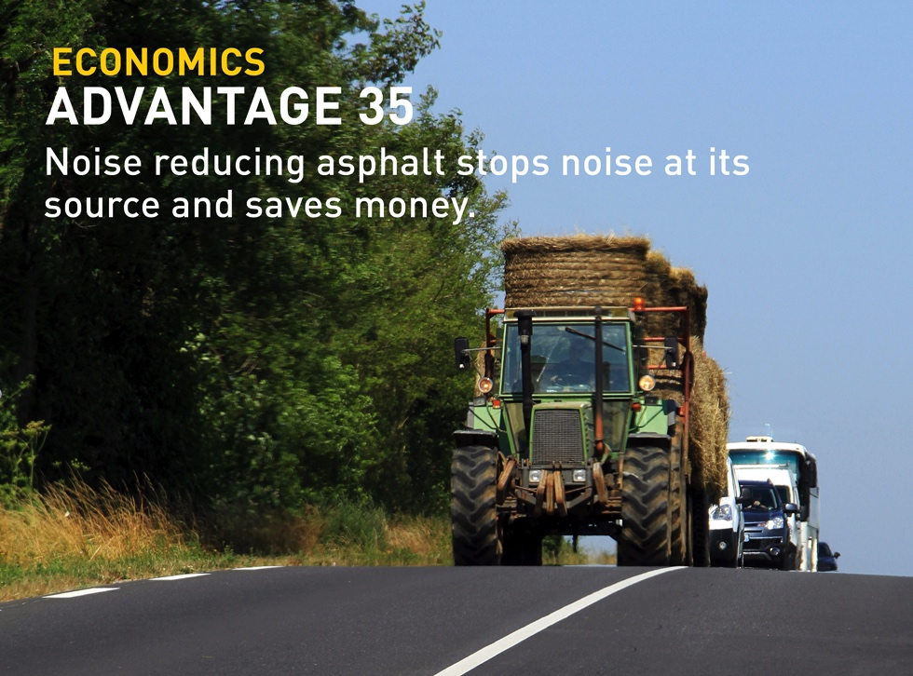

Slide 10


Slide 11


Slide 12


Slide 13
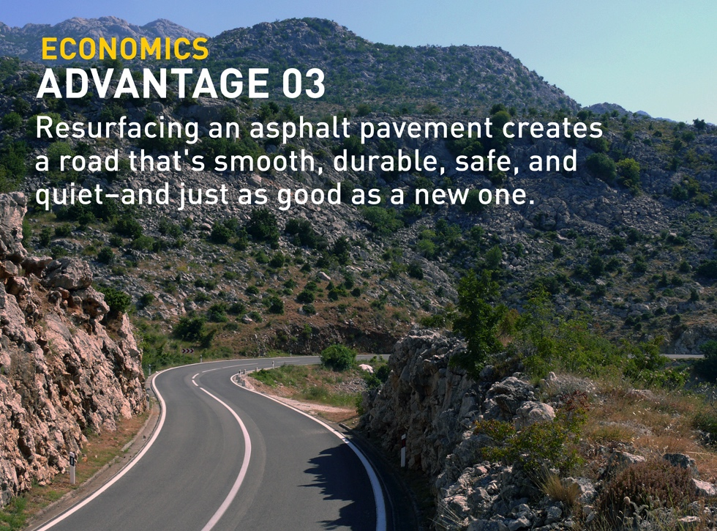

Slide 14

Sign up for our newsletter and other industry news at AsphaltAdvantages.com

Slide 15
Socialize with us on Facebook, Twitter, and LinkedIn.
Join the conversation!
#AsphaltAdvantages

Slide 16
supports the need to invest in our roads!
AsphaltAdvantages.com
^{#AsphaltAdvantages}

